Slide 1
Spendsnap-finance app [mobile application development Project]
PRESENTED BY-
Agastya 21CSU372 Nikhil 21CSU414
Sanjog 21CSU417 Ritin 21CSU415
Rohan 21CSU351

Slide 2
What is spendsnap??
Personal Finance Management app
Developed using Flutter
Can integrate with Bank APIs(if available)
Uses Provider for real time UI updates and data persistence
Has various budgeting tools
Is easy to access

Slide 3
SHOW stoppers
Income and Expense Tracking
Budgeting Tools
Financial Goal Setting
Automated Data Import
Expense Categorization
Efficient Data Management

Slide 4
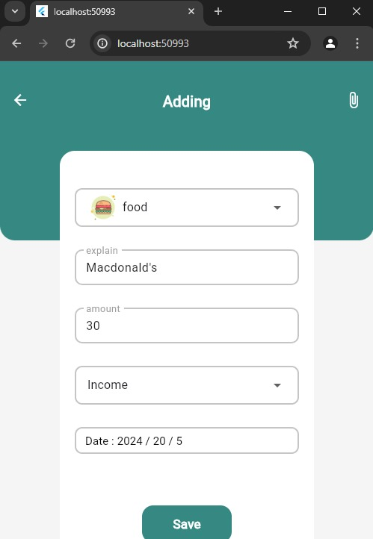
App snippets

Slide 5
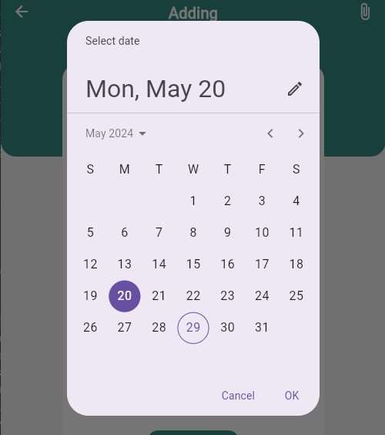
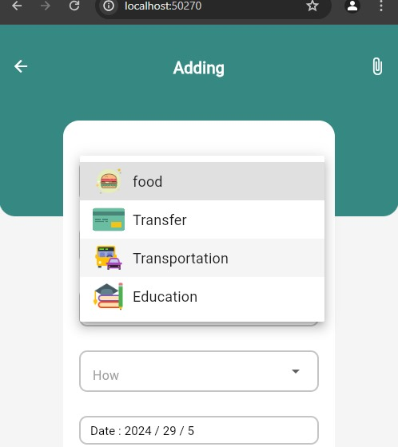

Slide 6
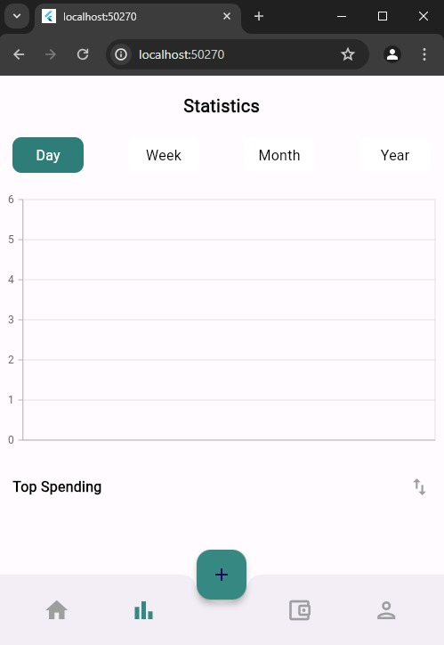
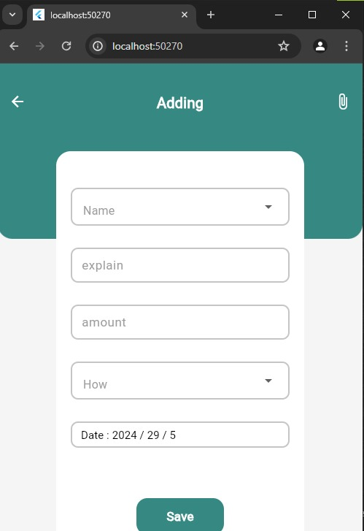
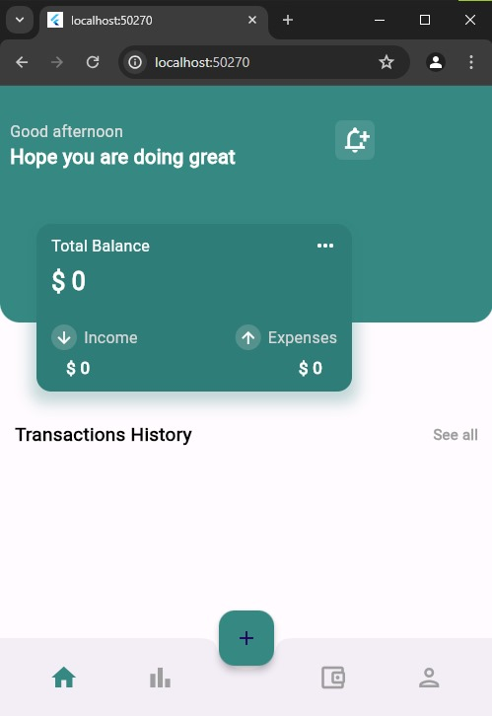

Slide 7
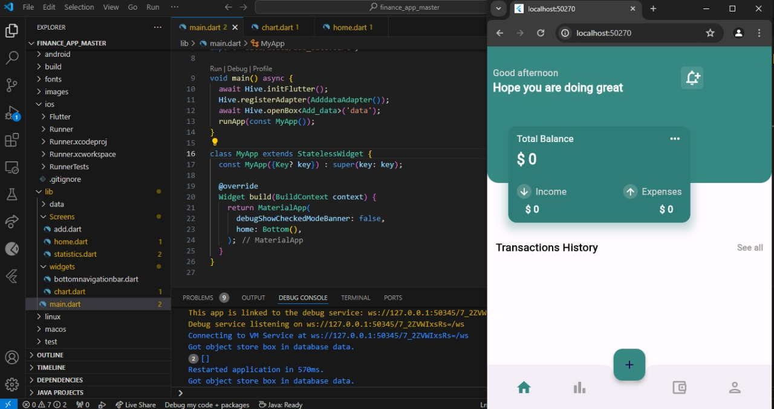

Slide 8
Tech stack
Flutter
Dart
RESTful APIs
Provider or Bloc
SQLite or Hive

Slide 9
components
Income and Expense Tracking
Budgeting Tools
Bank API Integration
Expense Categorization
Data Persistence with Provider or Bloc
Financial Goal Setting

Slide 10
UI
- Dashboard: Displays an overview of the user's financial status, including
total income, expenses, and remaining budget.
- Transaction List: Shows all income and expense transactions, with
options to add, edit, or delete entries.
- Budgeting Screen: Allows users to set and manage budgets for different
categories.
- Goals Screen: Users can set financial goals and track their progress.
- Settings: Options to manage bank API integrations, user preferences, and
app settings.

Slide 11
THANK YOU

